Slide 1
OSTutorLLM
PROJECT DETAILS
Course: BCSE303L — Operating Systems
Institution: VIT Vellore
Team: [INSERT TEAM NUMBER]
Members: Gautham. G 24BCE2148
Faculty: [INSERT FACULTY NAME]
A Course-Grounded Operating Systems Tutor
Course Project · Academic Session 2025–2026
Grounded learning and interactive practice for undergraduate operating systems.
Notes:
Introduce OSTutorLLM as an undergraduate operating systems course tutor combining grounded retrieval and interactive practice.

Slide 2
PROJECT CONTEXT
Introduction and Objectives
PROBLEM
OBJECTIVES
Challenges in course study
Targeted system capabilities
OS learning resources are spread across slides, notes, and lab manuals.
General chatbots may lack grounding in uploaded course material.
Students need explanations, practice, and numerical verification.
Generate OS explanations with inspectable source evidence.
Provide MCQs, viva practice, and shell-lab exercises (adaptive practice).
Track topic-wise performance and verify CPU schedules.
Focus: Verifiable course grounding, curriculum-aligned self-testing, and deterministic scheduling evaluation.
BCSE303L Operating Systems · Project Scope & Core Requirements
OSTutorLLM
2
Notes:
Present the three core problems faced by students and the three corresponding technical objectives of OSTutorLLM.

Slide 3
SYSTEM DESIGN
Methodology and System Architecture
PIPELINE 1: DOCUMENT PREPARATION
1
2
3
4
Course documents
Chunking
MiniLM embeddings
Chroma index
Extract PDF/PPTX text; retain filenames and page/slide numbers.
Split content into overlapping chunks.
Generate MiniLM embeddings.
Build a Chroma index.
PIPELINE 2: QUESTION ANSWERING (RETRIEVAL PRECEDES GENERATION)
1
2
3
4
Student question
Hybrid retrieval
Evidence + Qwen3-4B
Answer with sources
Student question.
Combine semantic retrieval with BM25 keyword ranking.
Supply retrieved evidence to Qwen3-4B for answer generation.
Answer with sources.
Technology stack: Gradio: browser interface · SQLite: quiz progress · Colab GPU: model execution · Google Drive: saved documents and progress
Qwen3-4B is pretrained and used with RAG.
OSTutorLLM
3
Notes:
Walk through the two-stage pipeline: offline document preparation and online hybrid question answering, highlighting that retrieval strictly precedes generation.

Slide 4
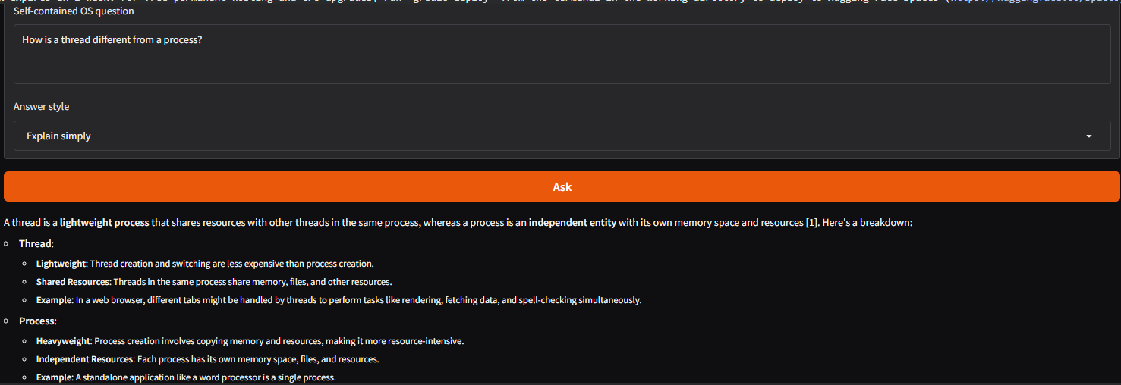
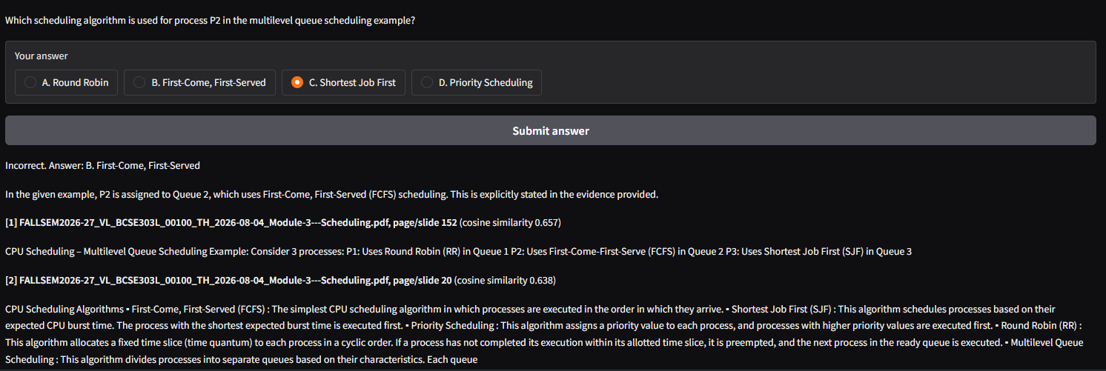
TUTOR INTERFACE
Implementation and Results — OS Tutor
Key implementation points
Implemented browser-based OS question answering.
Displayed retrieved filenames and page/slide references.
Added simple, exam-answer, viva, and shell-lab modes.
Added MCQ generation, grading, and saved topic-wise progress.
Used recent quiz performance to request difficulty levels.
Skipped generation when no evidence passed the retrieval threshold.
UI CAPTURE SLOT A
[INSERT ACTUAL ANSWER AND SOURCE-EVIDENCE SCREENSHOT]
Screenshot placeholder: Q&A tab, generated response, cited slide number
Demonstration prompt: “Explain FCFS scheduling. Is it preemptive or non-preemptive?”
Expected concept (not a captured result): “Arrival-order scheduling; non-preemptive execution.”
Interface verification conducted via Gradio web runtime on Colab GPU instance.
OSTutorLLM
4
Notes:
Review tutor functionalities including grounded answers, multimodal practice modes, threshold checks, and placeholder captures.

Slide 5
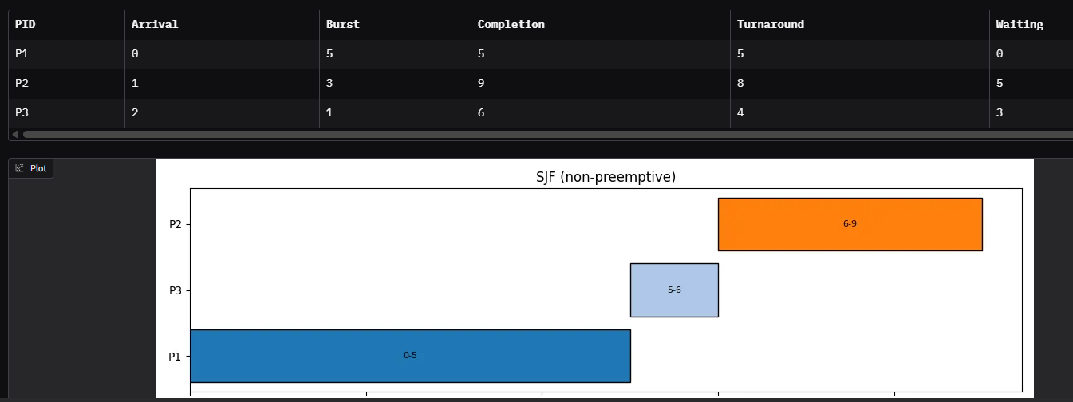
LAB MODULE
Implementation and Results — Scheduling Lab
Deterministic calculations
WORKED EXAMPLE — TIME UNITS
Added an interactive CPU scheduling calculator.
Implemented FCFS, non-preemptive SJF, and Round Robin.
Calculated completion, turnaround, and waiting times in Python.
Displayed execution intervals using a Gantt chart.
Python calculates the numbers; the LLM explains concepts.
Algorithm | Average Waiting Time | Average Turnaround Time
FCFS | 3.33 | 6.33
Non-preemptive SJF | 2.67 | 5.67
Round Robin, quantum 2 | 3.33 | 6.33
Worked-example input: P1: arrival 0, burst 5 · P2: arrival 1, burst 3 · P3: arrival 2, burst 1 · Round Robin quantum: 2
Assumptions: Single CPU; one CPU burst per process; no I/O; zero context-switch overhead.
Worked example metrics computed programmatically; values illustrate
deterministic execution behavior.
OSTutorLLM
5
Notes:
Explain the division of labor: Python guarantees exact numeric schedules while the LLM provides contextual conceptual explanations.

Slide 6
SUMMARY & ROADMAP
Conclusion and Future Scope
CURRENT SYSTEM STATUS
ROADMAP & CONSTRAINTS
Implemented
Limitations and next steps
Integrated course-grounded explanations and source evidence.
Added practice generation and rule-based difficulty adaptation.
Added deterministic CPU scheduling verification.
Answer quality depends on document coverage and extraction.
Generated answers and MCQs require factual review.
Future work: OCR, formal evaluation, and independent hosting.
Current deployment: Gradio interface connected to an active Colab runtime.
OSTutorLLM Project Assessment · BCSE303L Operating Systems
OSTutorLLM
6
Notes:
Summarize completed deliverables alongside acknowledged technical dependencies, evaluation needs, and planned system extensions.

Slide 7
ACADEMIC CITATIONS
References
Lewis, P., et al. (2020). Retrieval-Augmented Generation for Knowledge-Intensive NLP Tasks. https://arxiv.org/abs/2005.11401
Reimers, N., and Gurevych, I. (2019). Sentence-BERT: Sentence Embeddings using Siamese BERT-Networks. https://aclanthology.org/D19-1410/
Qwen Team. Qwen3-4B model card. https://huggingface.co/Qwen/Qwen3-4B
Sentence Transformers. all-MiniLM-L6-v2 model card. https://huggingface.co/sentence-transformers/all-MiniLM-L6-v2
Chroma. Official documentation. https://docs.trychroma.com/
Gradio. Official documentation. https://www.gradio.app/docs
Publications, foundational model documentation, and open-source system libraries used in this project.
OSTutorLLM
7
Notes:
Provide canonical references for RAG, Sentence-BERT, model weights, and underlying retrieval frameworks.

